Slide 1
FEM2401 Malaysian Politics & Society TOPIC 10: MAJOR NATIONAL POLICIES
Lecturer:
MUHAMMAD AMIR BIN MUNSHI

Slide 2
CONTENT:
Social and economic policies
Social policies
Developmental policies
Foreign policy
Regional and international cooperation
LEARNING OUTCOME:
To discuss selected major policies
To elaborate the important of some policies

Slide 3
POLICY OR PUBLIC POLICY
What is the meaning of public policy?
Thomas Dye defined public policy as “anything a government chooses to do or not to do.”
is a course of action adopted and pursued by a government
the actions of government and the intentions that determine those actions
A government’s plan and guideline to run a country
Two types of public policy
Domestic policy
Foreign policy

Slide 4
PUBLIC POLICIES IN MALAYSIA
PUBLIC POLICIES IN MALAYSIA
Social Policies
Policies that priotise social values based on justice, spirituality and humanity
Emphasises social development and community welfare
Eg: National Social Policy, National Women Policy, National Policy for Elderly, National Education Policy, National Youth Policy, etc
Development Policies (economy)
Policies that focus on physical development without neglecting humanities. The goal is balanced development
Eg: New Economic Policy, National Development Policy, National Transformation Policy
Foreign Policies
Policies or guides in determining Malaysia’s relationship with other countries
Eg: Look East Policy, Cooperation with ASEAN, OIC, United Nations, etc
Two types of public policy
Domestic policy
National Social Policies
National Development Policies
Foreign policy
Bilateral relationships/diplomacy
Multilateral policies relationships/diplomacy
Regional and international organisation
Ultimate aim of all public policies in Malaysia – NATIONAL UNITY
Major public policies in Malaysia – check the Prime Minister Office Website https://www.pmo.gov.my/category/government-policies/

Slide 5
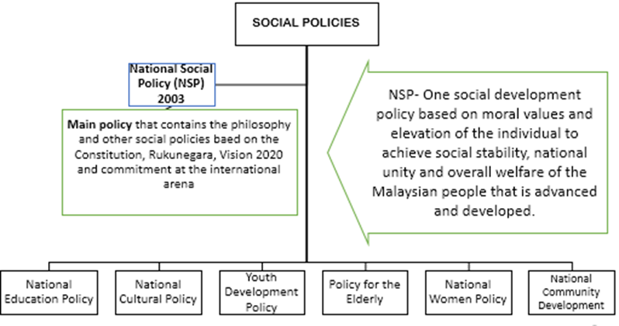
SOCIAL POLICIES
The Malaysian Government’s effort to create a social harmony and social welfare in order to maintain the political stability.
The overriding goal of all social policies is to maintain the social welfare and cohesion.
Will address the specific needs of the society. May different from national development policies but serve the similar purpose that to assist the promotion of national integration and unity.

Slide 6
SOCIAL POLICIES
Ministry of Women, Family and Community Development (KPWKM) – is one of the ministries that responsible in most of the social development in Malaysia such as social welfare: children, women, family, community, children, older people, destitute, homeless, disaster victim, disabled. Policies under this ministry’s responsibility on National Social Policy National Women Policy, Policy for the Elderly, National Children Policy etc.
Ministry of Youth – responsible for Youth development and issues – National Youth Policy
Ministry of Tourism and Culture (National Department for Culture and Arts) – responsible for National Cultural Policy.

Slide 7
NATIONAL SOCIAL POLICY (NSP)
Officially adopted by the Government in 2003, the NSP seeks to create a progressive and established Malaysian society with every member having the opportunity to develop his/her potential to the optimum in a healthy social environment based on the qualities of unity, resilience, democracy, morality, tolerance, progress, care, fairness and equity.
Umbrella policy to other Social Policies

Slide 8
NATIONAL SOCIAL WELFARE POLICY
In seeking to achieve a contented and strong society for national development, the NSWP shall develop human potential to the optimum and to strengthen society to face current social challenges, create various facilities for enhancing self-development and development of the individual, and build and inculcate the spirit of mutual help and assistance to reinforce a caring culture.
NATIONAL POLICY FOR THE ELDERLY
This policy was adopted to establish a society of the elderly who are contented, dignified, possessed of a high sense of self-worth, and optimising their potential, as well as to ensure that they enjoy all opportunities besides being given the care and protection as members of a family, society and the nation.

Slide 9
NATIONAL POLICY ON WOMEN
The main objectives of this policy are to ensure an equitable sharing in the acquisition of resources, information, opportunities and benefits of development for men and women.
The objectives of equality and justice must be made the essence of development policies which must be people oriented so the women, who constitute half the nation's population, can contribute and realize their potentials to the optimum; and to integrate women in all sectors of development in accordance with their capabilities and needs, in order to enhance the quality of life, eradicate poverty, ignorance and illiteracy, and ensure a peaceful and prosperous nation.
The Ministry also gotten the Government to agree towards achieving a minimum of a 30% representation of women in decision making positions in the public sector.

Slide 10
NATIONAL CULTURE POLICY
Three principles as the National Culture Policy as follows :
1) The national culture must be based on the indigenous culture of this region :
The region covers Malaysia, Indonesia, Philippines, Singapore, Brunei, Thailand and Cambodia, as well as the South Pacific islands (Polynesia, Melanesia and Oceania) and Malagasy. The region has been an important part of Malay civilization and culture. The Malay culture today is a way of life and symbol of identity of more than 200 million people who speak the same language. The culture of the indigenous people from this region, refers to the Malay culture, forms the basis of the National Culture Policy.
2) Suitable elements from the other culture may be accepted as part of the national culture
This principle takes into consideration the multi-cultural aspects in a multi-racial society. Hence, cultural elements of the Chinese, Indians, Arabs, Westerners and others which are considered suitable and acceptable are included in the national culture. Such acceptance must be in accordance with the provisions in the Constitution and the principles of Rukun Negara , as well as national interest, moral values and the position of Islam as the official religion of the country.
3) Islam is an important component in the formulation of the national culture
Religion or the belief in God is important in the development process of a country and also in the personal development of her people. Islam provides guidance to mankind and fulfills the physical and emotional needs. Hence Islam is an important element in formulating the National Culture Policy based on its position as the official religion of the country

Slide 11
NATIONAL EDUCATION POLICY
Brief History:
Consolidation Era : Razak Report 1956 and Education Ordinance 1957
Education Committee 1956 was formed to formulate national education system
Ultimate goal of making Malay the key medium of instruction - Also ensure the language and culture of other ethnic groups were also protected
Review Era: Rahman Talib Report 1960, Education Act 1961 and Aminudin Baki Report, 1964
Free education for national primary school 1962
A Malaysian oriented curriculum
Upper secondary education offers two streams, academic and vocational
Schooling from 9 to 11 years
improving the overall quality of education management

Slide 12
Re-examine the National Education Policy: Cabinet Committee Report 1979
To ensure the national objective of creating an integrated and united Malaysia society and a skilled manpower for national development can be achieved
Education Bill 1995
To produce world-class education in terms of quality in order to achieve national aspirations
The National Education Philosophy is the basis for the national education policy
Primary education of 5-7 years
Pre-school education as part of the national education system
Enhancement of technical & polytechnic education
Provisions to regulate private education
Under the responsibility of Ministry of Education (Primary and Secondary Education) and Ministry of Higher Education (Higher Education)
Recent efforts in improving National Education Policy
Eleventh Malaysia Plan (11MP) Education
Malaysia Education Blueprint 2013 – 2025
Some issues in Education Policy
Medium of instruction in education (School and University; currently Malay is official medium in school and public university, not in private)
Assessment – exam orientation

Slide 13
NATIONAL YOUTH POLICY
Seek to organise and supervise various programmes beneficial to the youth
Some basic principles:
To instill the spirit of Rukun Negara
To promote the spirit of unity , volunteerism and autonomy
To promote participation in the process of national planning
The development of the Policy
1985: First National Youth Policy was introduced
1997: National Youth Development Policy
2015: National Youth Policy (The latest)
Focus on 15-30 years old
“Strenghtening the human capital and potential of youth as a driver for the future strategic of the country in accordance of Federal Constitution and Rukun Negara”

Slide 14
NATIONAL DEVELOPMENT POLICIES
MAJOR DEVELOPMENT POLICIES
New Economic Policy
National Development Policy,
National Vision Policy (Vision 2020),
National Transformation Policy (1M, ETP, GTP, MEB, RM10, RM11)
SPECIFIC POLICIES
Privatization Policy, Agricultural Policy
The Government efforts in developing the country and society in order to maintain balanced development – sustainable development
Since 1971, all the national policies are aimed to promote national integration and unity.

Slide 15
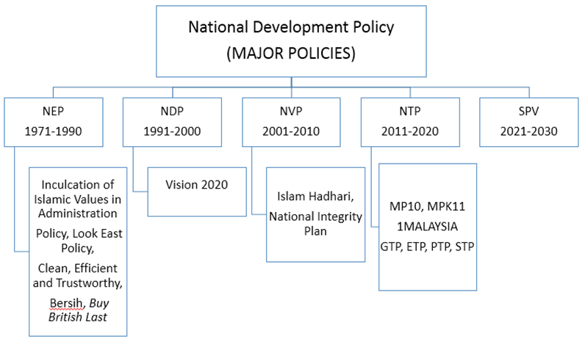

Slide 16
NEW ECONOMIC POLICY (NEP) 1971 -1990
NATIONAL DEVELOPMENT POLICY (NDP) 1990-2000
NEP was a watershed in the Malaysian economic policy history. (reaction to 1969 riot) - was a social re-engineering and affirmative action program for bumiputera (indigenous).
The NEP underscored the importance of achieving socio-economic goals alongside pursuing economic growth objectives as a way of creating harmony and unity in a nation with many ethnic and religious groups. The overriding goal was national unity.
Two pronged strategies were adopted: 1) to eradicate poverty for all Malaysians 2) to reduce and subsequently eliminate the identification of race by economic function and geographical location.
Policy target – official equity /shares for Bumiputera at least 30%, other Malaysian 40% and foreigners 30%
Other policies/programs during NEP; Malaysian Incorporated Policy, Privatization Policy and Look East Policy.
Replaced the Malaysian New Economic Policy in 1990 but continued to pursue most of NEP policies of affirmative action for bumiputera.
Other policies/program during NDP: Vision 2020 was introduced in 1991, National Telecommunication Policy 1994

Slide 17
NATIONAL VISION POLICY (NVP) 2001-2010
Was an extension of the NDP (1991-2000) and also the second phase of Vision 2020
The aims is to establish a united, progressive and prosperous Bangsa Malaysia that lives in harmony and engages in full and fair partnership
Other policies/program during NVP; National Integrity Plan.
VISION 2020
Introduced by the fourth Prime Minister of Malaysia, Mahathir bin Mohamad in 1991
The vision calls for the nation to achieve a self-sufficient industrialized nation by the year 2020
encompasses all aspects of life, from economic prosperity, social well-being, world-class educational, political stability, as well as psychological balance.

Slide 18
Mahathir outlined 9 strategic challenges for Malaysian to achieve in the year 2020.
Challenge 1: Establishing a united Malaysian nation made up of one ‘Bangsa Malaysia’ (Malaysian Race).
Challenge 2: Creating a psychologically liberated, secure and developed Malaysian society.
Challenge 3: Fostering and developing a mature democratic society.
Challenge 4: Establishing a fully moral and ethical society.
Challenge 5: Establishing a matured liberal and tolerant society.
Challenge 6: Establishing a scientific and progressive society.
Challenge 7: Establishing a fully caring society.
Challenge 8: Ensuring an economically just society, in which there is a fair and equitable distribution of the wealth of the nation.
Challenge 9: Establishing a prosperous society with an economy that is fully competitive, dynamic, robust and resilient.

Slide 19
DEVELOPMENT POLICIES UNDER SIXTH PRIME MINISTER (DATO’ SERI NAJIB)
National Transformation Policy (NTP) 2011-2020
NTP was launched by Prime Minister Najib Tun Razak during the tabling of Budget 2010 to replace the National Vision Policy (NVP)
1Malaysia (People First, Performance Now)
1M programs: 1Malaysia clinics, 1Malaysia Development Berhad, Kedai Rakyat 1Malaysia (1Malaysia People's Grocery Stores)
Government Transformation Programme (GTP) to transform Malaysia into a developed and high-income nation by 2020;
Economic Transformation Programme (ETP) to transform the national economy.
Social Transformation Programme
Politics Transformation Programme

Slide 20
SHARED PROSPERITY VISION (SPV) 2030 (Wawasan Kemakmuran Bersama)
• This vision is a continuation from Vision 2020 espoused by Tun Dr Mahathir.
• The primary aim of the SVP is to provide a decent standard of living to all Malaysians by 2030.
• Three primary objectives:
• Development for all
• Addressing Wealth and Income Disparities
• United, Prosperous and Dignified Nation
• Further details : http://www.epu.gov.my/sites/default/files/2020 02/Shared%20Prosperity%20Vision%202030.pdf

Slide 21
FOREIGN POLICY
Types of relationship (foreign relations
Prime Ministers’ approaches
Regional and international cooperation
MALAYSIA’S FOREIGN POLICY
An independent, principled and pragmatic foreign policy, founded on the values of peace, humanity, justice, and equality
Key principles of Malaysia’s foreign Policy:
Promoting and defending Malaysia’s national interest
Defending and promoting the country’s national security
Protecting and promoting the country’s vital economic interests
Safeguarding Malaysia’s socio-political system
Building an international system based on the principles of international law and the principle of justice

Slide 22
Ministry of Foreign Affairs (Wisma Putra) is responsible to conduct Malaysia's foreign relations with other
Largely influenced and shaped by three key factors:
Domestic factors
Extension of domestic/public policies
Its unique demography
External factors
Global and regional events, trends and process
Its strategic location in Southeast Asia
its attributes as a trading nation
The idiosyncratic factors
Leadership of the Prime Ministers

Slide 23
PRIME MINISTER’S APPROACHES
1. Tunku Abdul Rahman : 1957-1970
2. Tun Abdul Razak : 1970-1976
• Pro- Western and Anti- Communist Approach
• Due to: Communist insurgency during his tenure, Confrontation with Indonesia and Cold War
• Non-alignment policy
• Due to: The end of Confrontation with Indonesia, Communist victory in Indochina, the ending of treaty with British in 1971
• Involve in non-alignment movement and establish a strong regional alignment through ASEAN

Slide 24
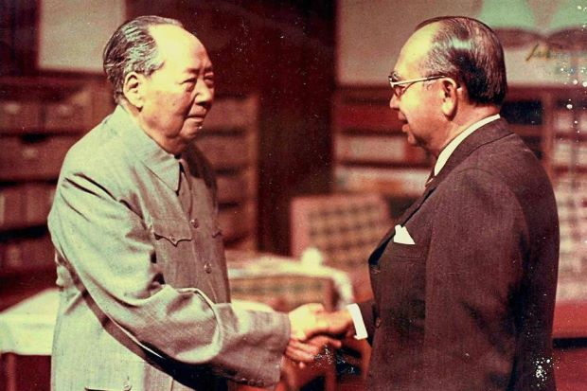
Tun Razak and Chairman Mao shaking hands when they met in Beijing

Slide 25
3. Tun Hussein : 1976-1981
4. Tun Dr. Mahathir : 1981-2003
Non-alignment policy and ASEAN
Strengthening relationship with ASEAN countries , established bilateral relationship with China (to persuade China to stop supporting Communist Party of Malaya)
Changed the orientation
Emphasis - economic interest, actively engaged in politics and economic relations
outspoken
Buy British Last, Look East Policy, United Nations, Palestinian issues, Apartheid, Antarctica and human rights issues.

Slide 26
5. Tun Abdullah : 2003-2009
6. Dato’ Seri Najib Tun Razak: 2009 – 2018
The continuation of the active foreign policy in international arena – especially in ASEAN and OICC)
The continuation of the active foreign policy in international arena – 2 ways relations (trading partner) especially with China, Japan, Singapore, US, Australia etc.

Slide 27
Tun Mahathir : 2018-2020
6. Tan Sri Muhyidin Yassin : 2020 – 2021
Focus on the relations with Japan/Asia’s countries
Continuity of the previous orientation and foreign relations.
Cooperation related to the measure and mechanism in managing the Covid19 pandemic.
Virtual diplomacy – APEC’s leader meeting 2020.

Slide 28
FOREIGN RELATIONS POLICIES
i. Look East Policy (cooperation with East Asia, cooperation with China)
ii. Relationship with Western countries (America, Europe)
iii. Type of cooperation: Economic/trade, politics, defense, cultural, religious (ZOPEAN, free trade, issue of MH 370, MH 17, etc)
iv. Relations/Cooperation with Southeast Asian Countries (ASEAN)
v. Relationship with Islamic countries (OIC), issue of Palestine
vi. Relationship with African countries
vii. International cooperation as United Nations, Commonwealth Countries, South-south Cooperation
viii. Relations with Asia Pacific Regional Cooperation such as APEC
ix. Relationship with Islamic countries (OIC), issue of Palestine
x. Relationship with African countries
xi. International cooperation as United Nations, Commonwealth Countries, South-south Cooperation
xii. Relations with Asia Pacific Regional Cooperation such as APEC

Slide 29

ASEAN
(The Organisation of South East Asian Countries)
Bangkok Declaration of 8 August, 1967.
Five Foreign Ministers of the member countries were signed the declaration;
Tun Adam Malik from Indonesia.
Tun Thanat Khoman from Thailand.
S.Rajaratnam from Singapore.
Narcisco Ramos from Philippines.
Tun Abdul Razak from Malaysia.
On 7 January 1984, Brunei Darussalam joined ASEAN.
In March 1999, Cambodia, Vietnam, Myanmar and Laos joined ASEAN.
Malaysia actively involved in ASEAN since its formation
Kuala Lumpur Declaration-27 November,1971 established Zone of Peace Freedom and Neutrality (ZOPFAN).

Slide 30
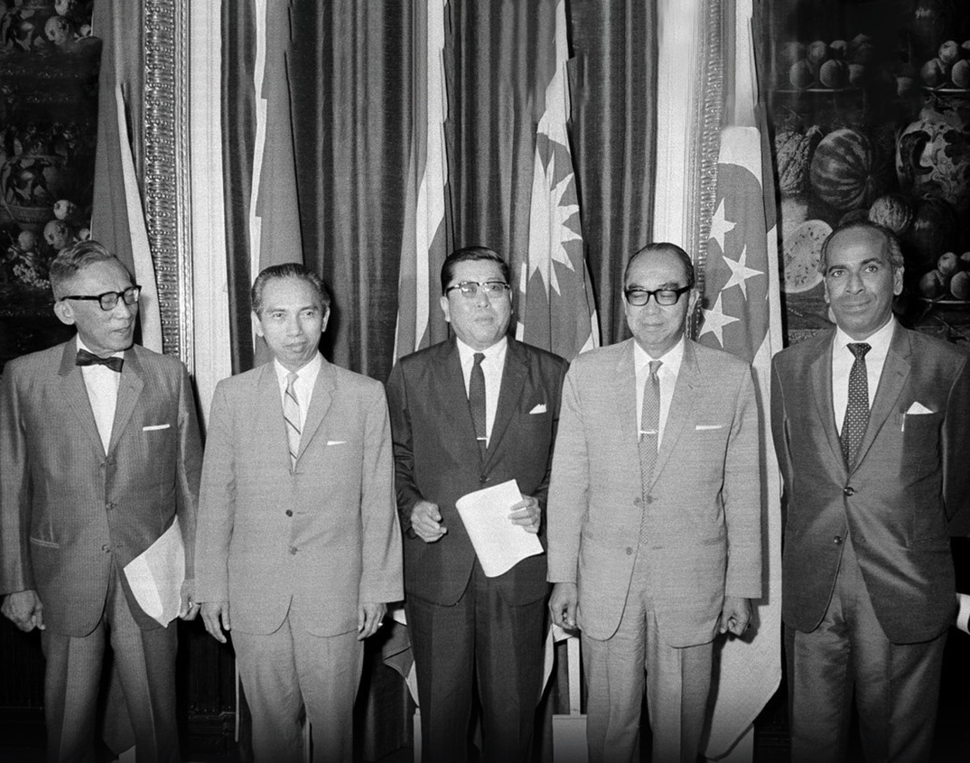
Southeast Asian Foreign Ministers responsible for the formation of ASEAN in 1967

Slide 31

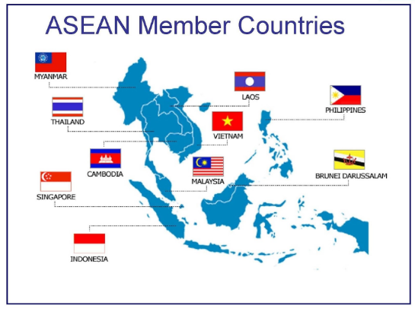

Slide 32
ASEAN 2015
Malaysia was chairman of ASEAN in 2015
‘ASEAN community’ 2015
Host for 26th ASEAN Summit (26-27 April 2015)
Host for 27th ASEAN Summit (19-21 November 2015)

Slide 33
The Asia-Pacific Economic Cooperation (APEC)
APEC was established in 1989 as a platform to discuss on mechanisms of the growing interdependence of the Asia-Pacific region.
APEC has 21 member countries: Australia; Brunei Darussalam; Canada; Chile; People's Republic of China; Hong Kong, China; Indonesia; Japan; Republic of Korea; Malaysia; Mexico; New Zealand; Papua New Guinea; Peru; The Philippines; The Russian Federation; Singapore; Chinese Taipei; Thailand; United States of America
Malaysia has progressively contributed to the initiatives of APEC in creating greater prosperity of the region by promoting regional economic integration

Slide 34
Malaysia and APEC
2020 - Malaysia hosted the 2020 APEC Economic Leaders’ Meeting – Virtual meeting. The theme “Optimizing Human Potential towards a Future of Shared Prosperity”. 3 priorities of 2020 meeting
PRIORITY AREA 1: Improve the Narrative of Trade & Investment
PRIORITY AREA 2: Inclusive Economic Participation through Digital Economy and Technology​
PRIORITY AREA 3: Driving Innovative Sustainability
https://www.myapec2020.my/en/apec-malaysia-2020/theme-priority-areas/

Slide 35
SOME MALAYSIA’S ACHIEVEMENT
The establishment of IIUM (from OIC)
Commonwealth (CHOGM) 1989 – Langkawi Declaration
NAM – NAM summit in KL 2003 (Chairman of NAM 2003-2006)
Host country for OIC meeting – OIC 10th Summit in KL (2003)
South-South Cooperation - formed Group of 15 (G-15) and Malaysia as pioneer in programmes for investment data exchange, and South-South Trade and Technology.
Non-permanent member of Security Council of UN 2014-2016
Host country for the 2020 APEC Economic Leaders’ Meeting – First Virtual Meeting – November 2020
Malaysia plays a significant role at regional and international arena.
The effort of Malaysia in maintaining the regional and global peace and cooperation – diverse and consistent – based on internal / domestic factors and environment

Slide 36
CONCLUSION
Social policies in Malaysia – how Malaysia strengthening their social and welfare development
Development/Economic policies in Malaysia – Malaysia’s effort in achieving a sustainable development
Foreign policy - the effort of Malaysia in maintaining the regional and global peace and cooperation.

Slide 37
Reflection
What is the meaning of public policy?
Describe the type of public policy in Malaysia?
What is the main purpose of social policy in Malaysia?
What is the objective of National Youth Policy?
Which ministry responsible for the welfare of community?
What was the backdrop of the introduction of NEP?
What were the objectives of NEP?
What was the major policy replaced the NEP?
Who introduced 1Malaysia programs?
Did Vision 2020 success?
What is the major policy replaced Vision 2020?
What are the key principles of Malaysia’s foreign policy?
Name examples of Malaysia’s relation with Asia’s countries.
What are Malaysian’s contributions to the peaceful coexistence at regional level?
What was the recent involvement/contribution of Malaysia at international level?

